Slide 1



Where to eat at UCI?
Team #1
Brian Ahn, Anthony Alvarez, Janette Bennett, Shyla Samuel

Slide 2
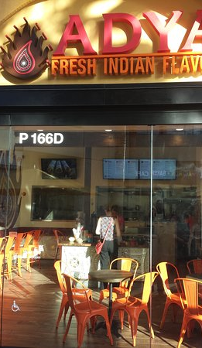
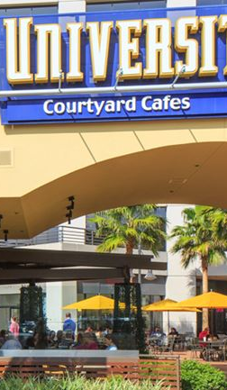
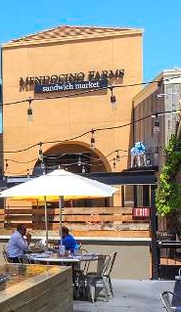
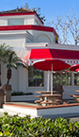
Project Description
z
z
Our project is to use Yelp to determine which restaurants are the most popular within a two mile radius of our classroom.
We are hungry, busy students with work, families and class responsibilities, with little time to grab a bite.
We’d like to know where the UCI campus community gets their sustenance. We’d also like to know if there is any preference by this community regarding price point, cuisine, or distance.

Slide 3
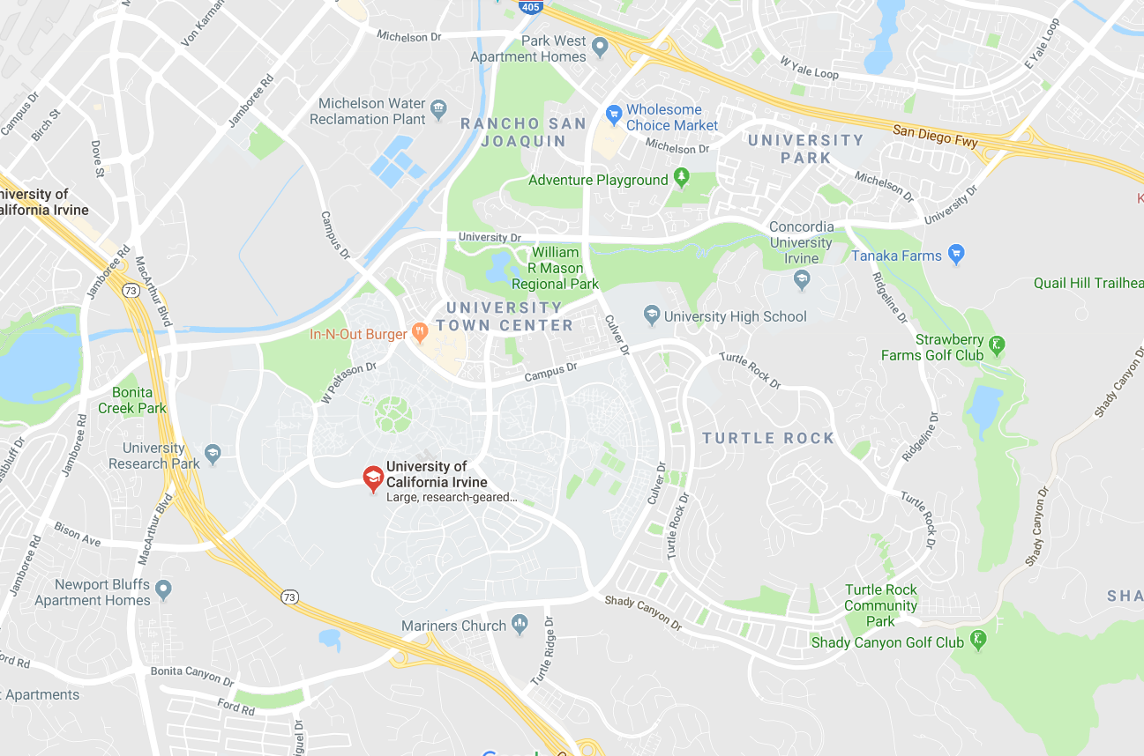
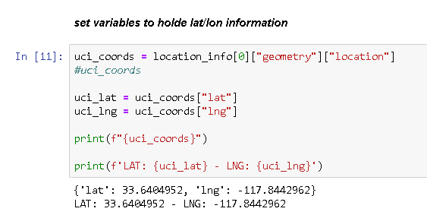
Where is the University of California Irvine (UCI)?

Slide 4
What we want to know!!!
What restaurants were closest to our location?
Which restaurants are the most affordable?
Which restaurants are the most popular by rating among the community?
Which restaurants are least recommended by the community?
Which restaurants had the most reviews?
How do we get to these restaurants?
Which restaurant was the best option for distance, affordability, rating, and reviews?

Slide 5
Hypothesis
Hypothesis
Null Hypothesis
There are more than 40 restaurants within a two mile radius of location from which to purchase meals before and after class with affordable price points and ratings.
If there are not more than 40 restaurants from which to choose within a 2 mile radius, then students will need to bring their own food.

Slide 6
Project Plan
Brainstorm
Discuss and Agree upon Project Topic, Description
Questions
Formulate Questions and Hypotheses
Tasks
Create responsibilities by team member
Data
Plan
Review Data Sources
Research API Documentation
Diagram Work Flow
Plot Coding Scheme
Create schedule for completing tasks

Slide 7
Project Tasks – Coding Scheme
1
Import dependencies, file operations, functions, and functional logic.
2
Using Google API, determine our location latitude and longitude.
5
Using Yelp API, pull reviews for restaurants from the first Yelp API Pull. Build second DataFrame for storing review data.
3
4
Reverse Geocode latitude and longitude to determine address information.
Using the address information, utilize Yelp API to get list of restaurants in a 2 miles radius. Build DataFrame to store data.
6
7
8
Using Vader Sentiment Analyzer, analyze review sentiments for our Yelp restaurants. Build DataFrame to store data.
Merged restaurant and sentiment DataFrames into one DataFrame.
Created graphs and charts to analyze our merged DataFrame.
9
Create map to show restaurant locations within walking distance from our location.

Slide 8
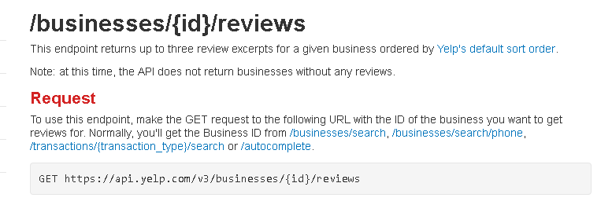
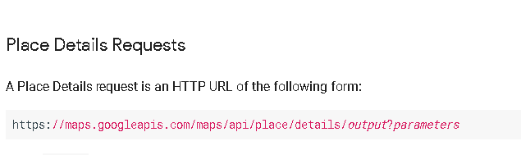
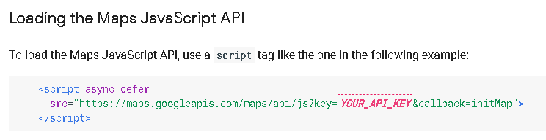
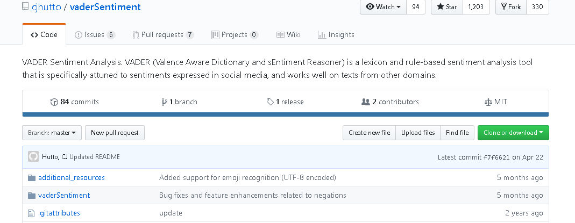
Data Sources
Yelp API
https://www.yelp.com/developers/documentation/v3/business_reviews
Google Place & Maps
https://developers.google.com/places/web-service/details
Vader Analysis
https://github.com/cjhutto/vaderSentiment

Slide 9
Data Exploration
Based on our review of the Yelp data, we determined our 2 mile radius was not feasible.
In order to determine the best place to “grab a bite to eat”, we reduced the radius to 1 mile to highlight establishments that can be walked to in less than 20 minutes.
Our data now reflects a 1 mile radius vs. 2 mile radius.

Slide 10
Data Clean-Up
Multiple aspects of data cleaning were addressed during the coding process.
Created miles to meters / meters to miles to perform calculations.
Reviewed JSON data lists to pull correct dictionary and/or lists for DataFrames.
Formatting dates and times.

Slide 11
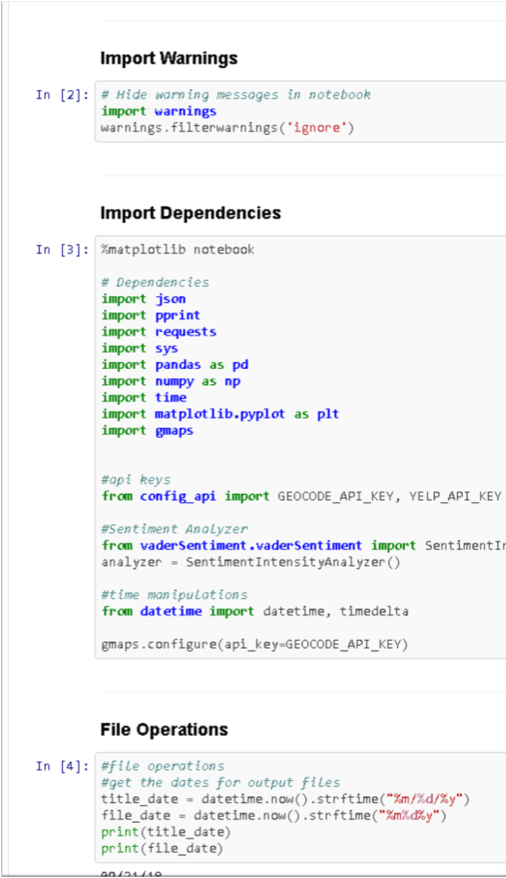
Python Coding
z
z
Execution of the Coding Scheme presented by Anthony Alvarez

Slide 12
Analysis Process
After running our final code with DataFrames, Graphs, and Maps, we reviewed the results by:
Distance
Yelp Rating
Yelp Average Dollar Value
Yelp Reviews through Vader Sentiment Analyzer
Google Maps
The answers to our questions, along with code and chart, graph, or map are…

Slide 13
What restaurants were closest to our location?
name | distance miles | distance meters | price rating | price value | review count | review rating
BC's Cavern on the Green | 0 | 0 | $ | 1 | 31 | 3
CafÃ© Espresso | 0.24 | 381 | $ | 1 | 35 | 3
Elements Cafe | 0.36 | 579 | $ | 1 | 12 | 4
Subway | 0.38 | 605 | $ | 1 | 31 | 3.5
CafÃ© Med | 0.49 | 791 | $ | 1 | 4 | 4.5
Pippin Commons | 0.52 | 833 | $ | 1 | 46 | 3
Med Ed Cafe | 0.54 | 869 | $ | 1 | 3 | 4.5
Crystal Cove Cafe | 0.57 | 919 | $ | 1 | 20 | 4
Au Bon Pain | 0.58 | 938 | $ | 1 | 35 | 3
Anthill Pub & Grille | 0.59 | 950 | $ | 1 | 380 | 4
Panda Express | 0.61 | 980 | $ | 1 | 39 | 2.5
Bridge Cafe | 0.62 | 1000 | $ | 1 | 2 | 4.5
Wahoo's Fish Tacos | 0.62 | 998 | $ | 1 | 26 | 3.5
Wendy's | 0.63 | 1016 | $ | 1 | 14 | 3
Thai Style | 0.66 | 1062 | $$ | 2 | 4 | 4.5

Slide 14
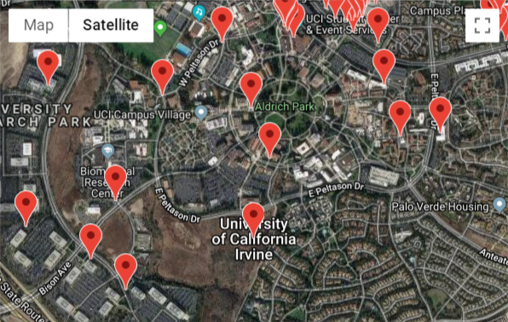
Restaurants Closest to our Location Google Maps Coding Result

Slide 15
Which restaurants are the most affordable?
name | distance miles | distance meters | price rating | price value | review count | review rating
BC's Cavern on the Green | 0 | 0 | $ | 1 | 31 | 3
CafÃ© Espresso | 0.24 | 381 | $ | 1 | 35 | 3
Elements Cafe | 0.36 | 579 | $ | 1 | 12 | 4
Subway | 0.38 | 605 | $ | 1 | 31 | 3.5
CafÃ© Med | 0.49 | 791 | $ | 1 | 4 | 4.5
Pippin Commons | 0.52 | 833 | $ | 1 | 46 | 3
Med Ed Cafe | 0.54 | 869 | $ | 1 | 3 | 4.5
Crystal Cove Cafe | 0.57 | 919 | $ | 1 | 20 | 4
Au Bon Pain | 0.58 | 938 | $ | 1 | 35 | 3
Anthill Pub & Grille | 0.59 | 950 | $ | 1 | 380 | 4
Panda Express | 0.61 | 980 | $ | 1 | 39 | 2.5
Bridge Cafe | 0.62 | 1000 | $ | 1 | 2 | 4.5
Wahoo's Fish Tacos | 0.62 | 998 | $ | 1 | 26 | 3.5
Wendy's | 0.63 | 1016 | $ | 1 | 14 | 3
Thai Style | 0.66 | 1062 | $$ | 2 | 4 | 4.5

Slide 16
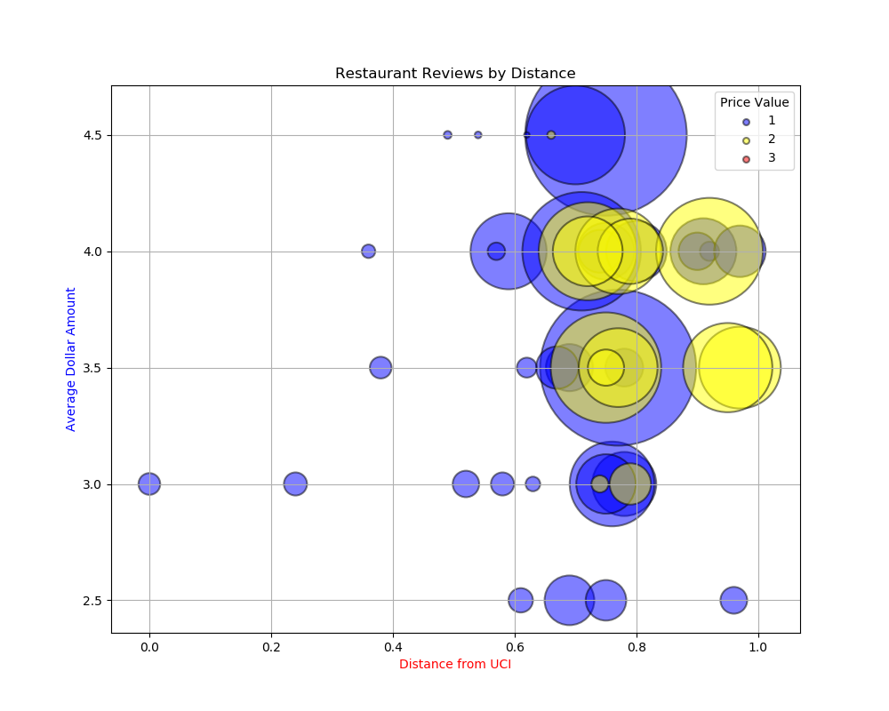
Which restaurants are the most affordable?
z
By plotting the distance (x-axis) vs average dollar amount (y-axis) and number of reviews, we can see that generally most of the restaurants within a 1 mile radius are listed as either 1 price ($) or 2 price ($$) value.
Therefore, most of the restaurants within a 1 mile radius are deemed affordable.

Slide 17
Which restaurants are the most popular by rating among the community?
name | distance miles | distance meters | price rating | price value | review count | review rating | type
CafÃ© Med | 0.49 | 791 | $ | 1 | 4 | 4.5 | Restaurants
Med Ed Cafe | 0.54 | 869 | $ | 1 | 3 | 4.5 | Cafes
Bridge Cafe | 0.62 | 1000 | $ | 1 | 2 | 4.5 | Cafes
Thai Style | 0.66 | 1062 | $$ | 2 | 4 | 4.5 | Thai
In-N-Out Burger | 0.7 | 1126 | $ | 1 | 641 | 4.5 | Burgers
Le Diplomate Cafe | 0.75 | 1210 | $ | 1 | 1713 | 4.5 | Bakeries
Elements Cafe | 0.36 | 579 | $ | 1 | 12 | 4 | American (New)
Crystal Cove Cafe | 0.57 | 919 | $ | 1 | 20 | 4 | American (Traditional)
Anthill Pub & Grille | 0.59 | 950 | $ | 1 | 380 | 4 | Bars
Blaze Fast-Fire'd Pizza | 0.71 | 1137 | $ | 1 | 922 | 4 | Pizza
Slapfish | 0.72 | 1166 | $$ | 2 | 630 | 4 | Seafood
DelSushi | 0.72 | 1158 | $$ | 2 | 319 | 4 | Japanese
Specialty's CafÃ© & Bakery | 0.74 | 1192 | $ | 1 | 120 | 4 | Bakeries
Nekter Juice Bar | 0.75 | 1202 | $ | 1 | 213 | 4 | Juice Bars & Smoothies
Mendocino Farms | 0.77 | 1242 | $$ | 2 | 479 | 4 | Sandwiches

Slide 18
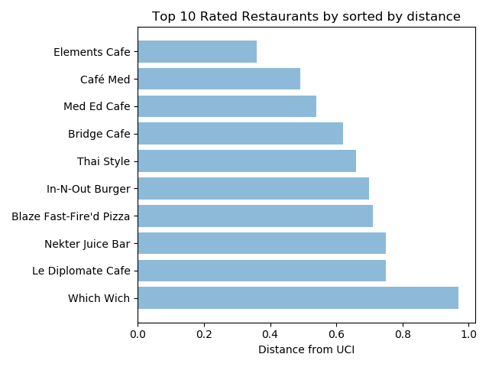
Which restaurants are the most popular by rating among the community?
z
This bar chart represents the top 10 rated restaurants (y-axis) by distance (x-axis).

Slide 19
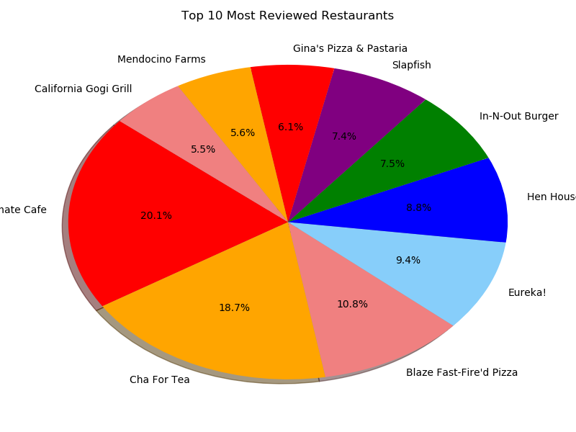
Which restaurants had the most reviews?
z
This pie chart represents the top 10 restaurants by reviews within a 1 mile radius and the percentage each restaurants owns of the top 10.

Slide 20
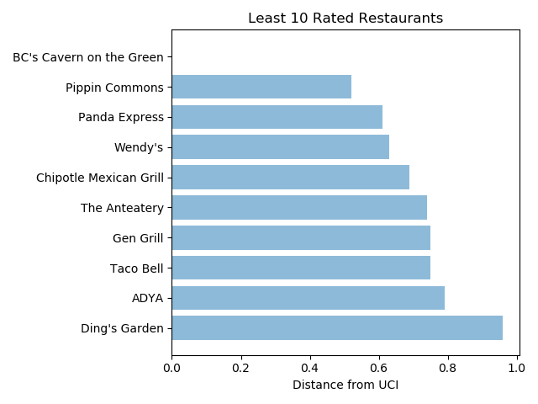
Which restaurants are least recommended by the community?
z
This chart represents the least rated restaurants within a 10 mile radius.
This is indicative of poor reviews, frequency of diners, and longevity in the community.

Slide 21
What do the reviews mean?
Vader Sentiment Analyzer

Slide 22
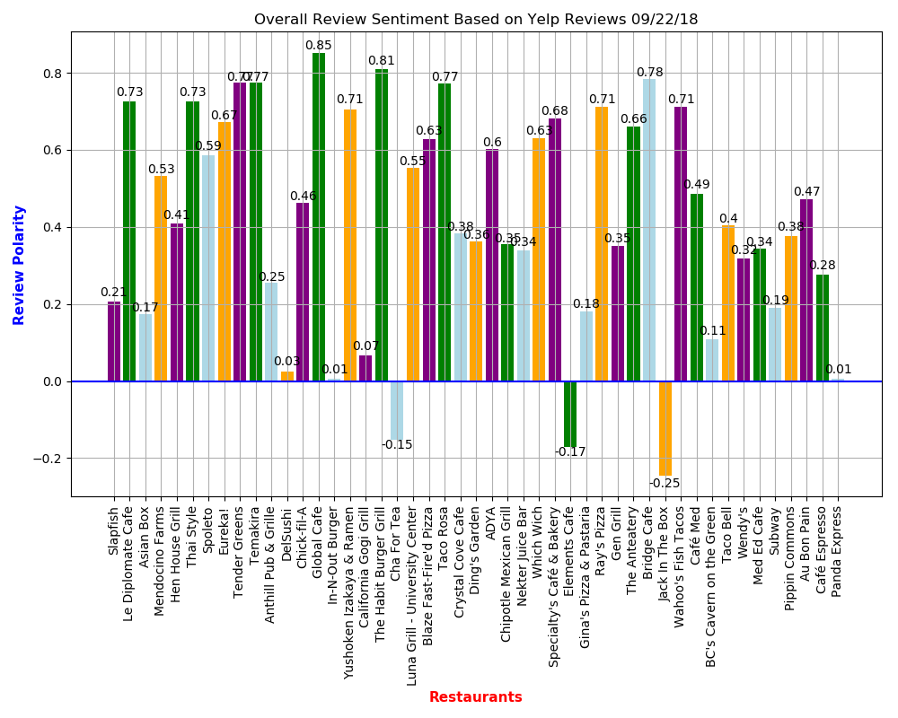
Which restaurant reviews had the highest compound sentiment rating after Vader Analysis?
z
Compound Score | Negative Score | Neutral Score | Postive Score | Restaurant
0.852 | 0.000 | 0.655 | 0.345 | Global Cafe
0.810 | 0.021 | 0.628 | 0.351 | The Habit Burger Grill
0.784 | 0.000 | 0.718 | 0.282 | Bridge Cafe
0.774 | 0.024 | 0.636 | 0.340 | Tender Greens
0.773 | 0.000 | 0.739 | 0.261 | Temakira
0.772 | 0.000 | 0.763 | 0.237 | Taco Rosa
0.725 | 0.000 | 0.797 | 0.203 | Le Diplomate Cafe
0.725 | 0.021 | 0.759 | 0.220 | Thai Style
0.712 | 0.000 | 0.815 | 0.185 | Wahoo's Fish Tacos
0.712 | 0.018 | 0.756 | 0.226 | Ray's Pizza
0.705 | 0.000 | 0.810 | 0.190 | Yushoken Izakaya & Ramen
0.681 | 0.026 | 0.754 | 0.220 | Specialty's CafÃ© & Bakery
0.673 | 0.000 | 0.796 | 0.204 | Eureka!
0.661 | 0.000 | 0.817 | 0.183 | The Anteatery
0.629 | 0.025 | 0.766 | 0.209 | Which Wich
Compound Score | Negative Score | Neutral Score | Postive Score | Restaurant
-0.245 | 0.082 | 0.894 | 0.024 | Jack In The Box
-0.170 | 0.156 | 0.783 | 0.060 | Elements Cafe
-0.153 | 0.105 | 0.839 | 0.056 | Cha For Tea

Slide 23
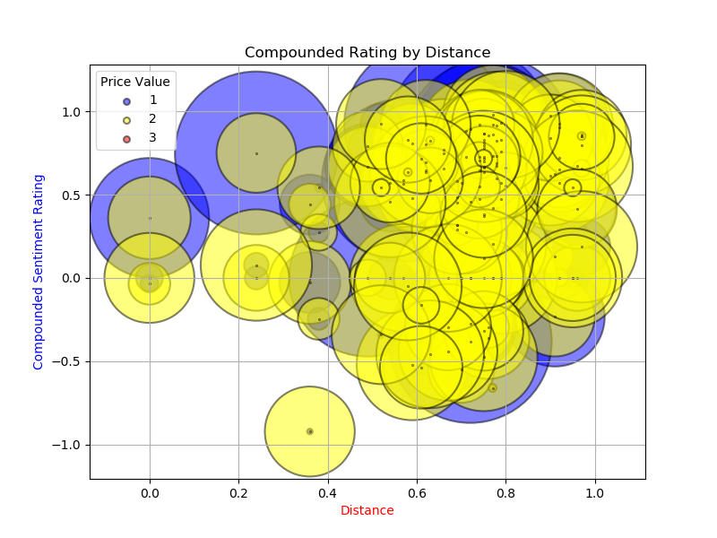
Overall Sentiment Ratings by Distance
z
This bubble plot represents most of the restaurants within 1 mile radius are generally reviewed as positive, especially within the lower and mid level price points.

Slide 24
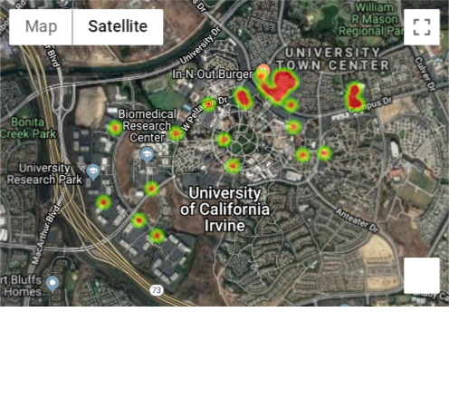
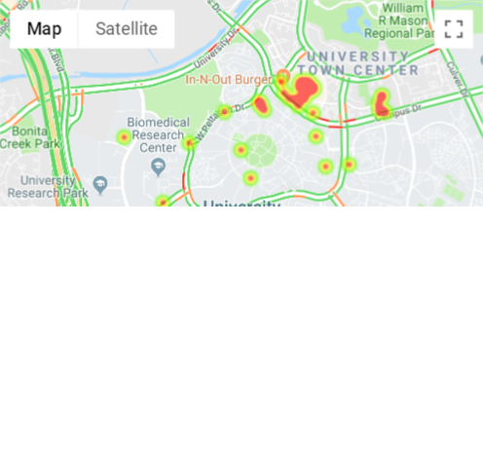
How do we get to these restaurants?
Heat Map of Activity
Traffic Map of Activity

Slide 25
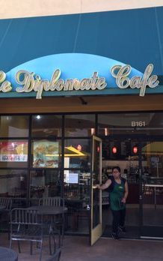
Conclusion Le Diplomate Cafe
The best option based on distance, price value, average rating, and average compound sentiment is….
z
z

Slide 26
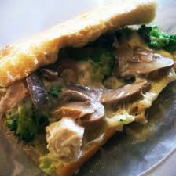
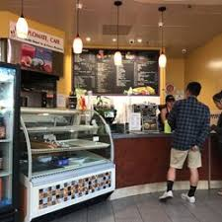
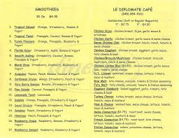
Le Diplomate Cafe
Bakery specializing in sandwiches and smoothies
4237 Campus Dr
0.75 miles away
$ - Inexpensive Price Value
1713 reviews
4.5 average review
0.725 compound score

